Slide 1
MIT Scratch 101

Slide 2
Feel free to experiment!
That is what programming is all about.

Slide 3
Scratch Basics

Slide 4
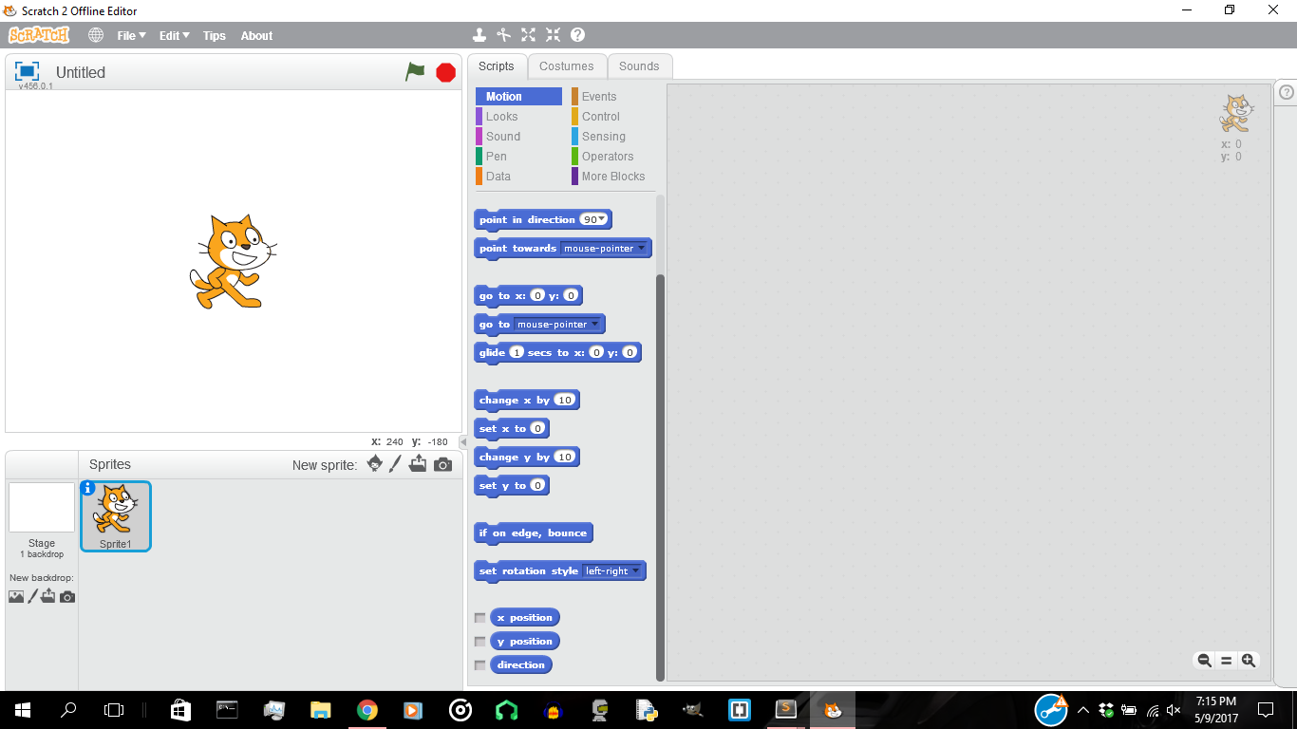
The User Interface

Slide 5
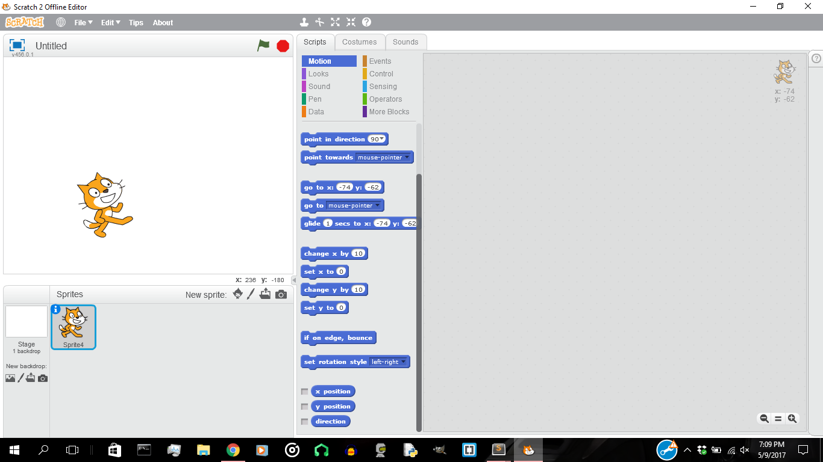
Playing with Sprites
Sprites are the objects
that perform actions in
your program.
They will execute your
code.
Notes:
Sprites are the things that perform actions in your program

Slide 6
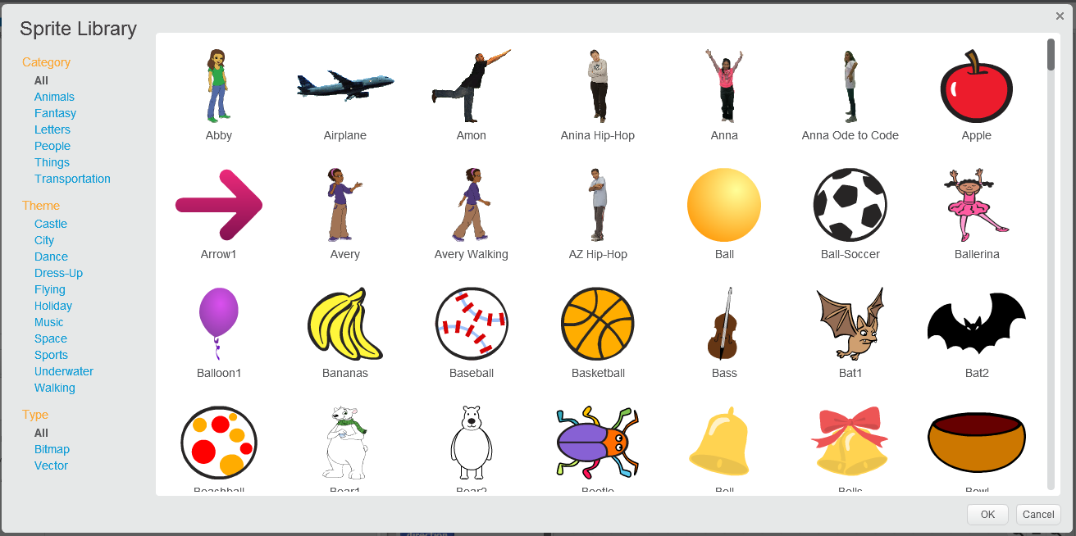
Adding a new sprite

Slide 7
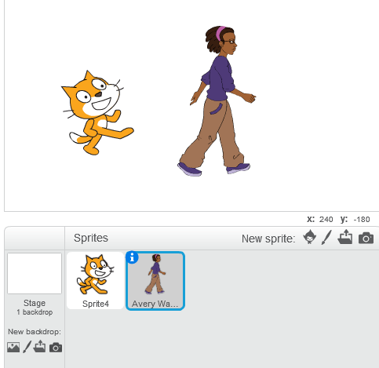
Adding a new sprite
Add a new sprite to the canvas
by double-clicking it.

Slide 8
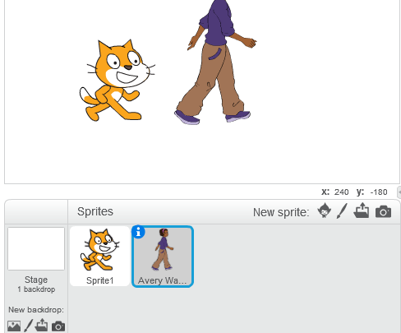
Drawing Your Own Sprite
Draw your own sprites by
clicking on the paint-brush
tool.

Slide 9
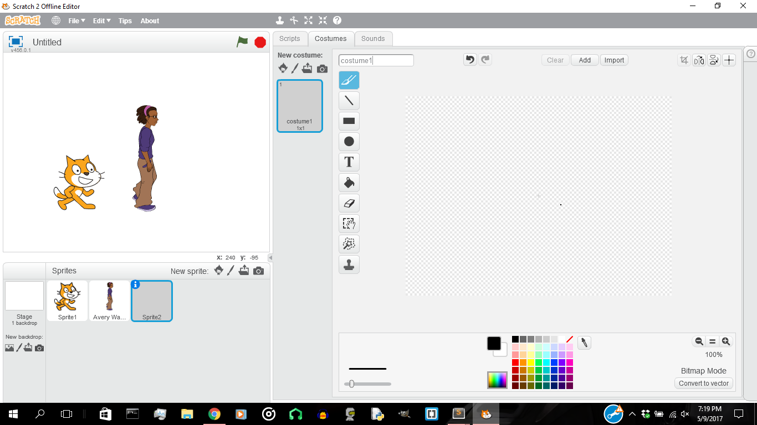

Slide 10
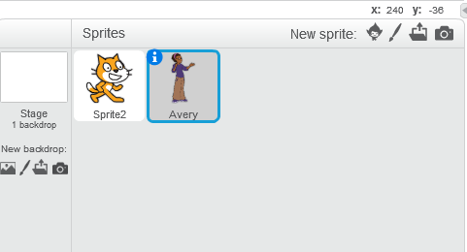
Making the Sprite Move
First, select the sprite that you'd like to move around, now we will need to understand blocks.

Slide 11

Blocks
Blocks allows users to interact with the sprites within the program through a logical and graphical mean.
In order to start, we must add this EVENT BLOCK.

Slide 12
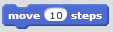
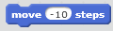
Making the Sprite Move
Move the sprite 10 steps rightward
Drag the block to the scripts area and double click it to see it in action.
Make the sprite move leftward by making the number -10.

Slide 13
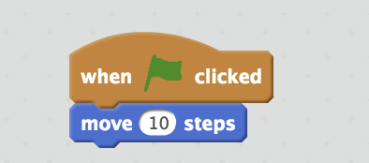
Making the Sprite Move
Attach it to the start event block to work through these blocks.

Slide 14
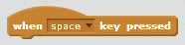
Adding an Event
When the spacebar is pressed, do something...
Different events may be detected by the program.
Attach this block to top of the move block.
Press the spacebar to make the sprite move.

Slide 15
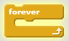
Adding Control
A loop allows code to be repeated a certain number of times.
The block on the left repeats a set of actions forever.
Drag your move block inside this forever block.
Attach the event block on top of the forever block.

Slide 16
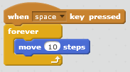

Slide 17
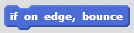
Adding Conditionals
Make your drawn sprite bounce around the screen forever when you click on the green flag.
Add this block so the sprite bounces whenever it hits the walls

Slide 18
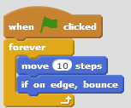

Slide 19
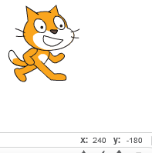
X and Y
Drag the sprite around the stage.
Notice the xy coordinates on the bottom right.
Try moving the sprite to x: 0 y: 0
x changes as it moves left / right
y changes as it moves up / down
Notes:
The x coordinate changes as they move it left/right
The y coordinate changes as they move it up/down

Slide 20
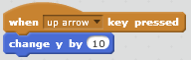
Moving Up and Down
Make the sprite move up by creating this block.
Negative values move down, while positive values move up.
How would you make the sprite move down by 10 units?
Notes:
Ask children to experiment on how to make the sprite move down

Slide 21
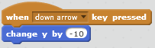

Slide 22
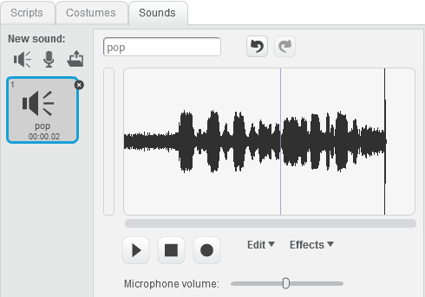
Making Noise
Click on the sounds tab and play with the sounds.
You may record or use the preset sounds

Slide 23

Making Noise
Play a selected sound using this block.
You may change the sound to the one you made or a preset one..
Notes:
Ask children to experiment on how to make the sprite move down

Slide 24
Challenge!
Open a new Scratch project.
Draw a trampoline sprite.
Select or make any other sprite.
Make the sprite bounce up and down the trampoline.
Make the sprite “meow” when it bounces.
Add another sprite which jumps more slowly.
Notes:
Walk around and guide the kids lol
If you could demonstrate it yourself, do it
Don't forget to save your works!

Slide 25
Other Blocks

Slide 26
Blocks Categories
Blocks are divided into categories based on their purpose and the important ones are listed below:
EVENT BLOCKS. Listens to input and gives output.
MOTION BLOCKS. Moves the sprites within the program.
DATA BLOCKS. Stores data for future use in the program.
CONTROL BLOCKS. Dictates the flow of events.
OPERATOR BLOCKS. Performs arithmetic operations.

Slide 27
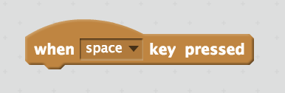
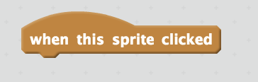
EVENT BLOCKS
Listens to keyboard presses and reacts when triggered.
Listens to mouse clicks on the sprite

Slide 28
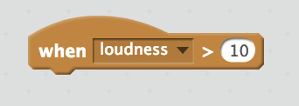
EVENT BLOCKS
Listens to background variables and reacts based on that.

Slide 29
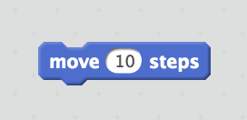
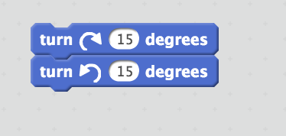
MOTION BLOCKS
Moves the sprite 10 points relative to the facing axis
Rotates the sprite by given degrees

Slide 30
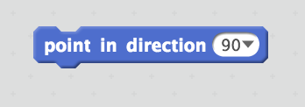
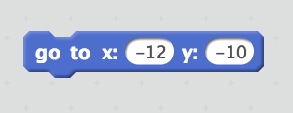
MOTION BLOCKS
Rotates the sprite to a certain degree
Changes the location of the sprite

Slide 31
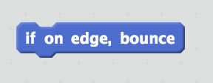
MOTION BLOCKS
Control statement that bounces sprite if sprite hits the edge of the screen

Slide 32

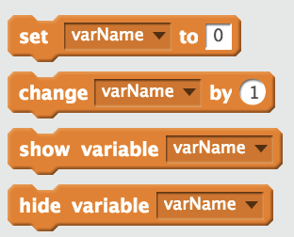
DATA BLOCKS
Creates a variable that stores data
SET. Assigns a variable to an integer
CHANGE. Changes given integer of a certain variable

Slide 33


CONTROL BLOCKS
Holds the flow for a certain number of second before proceeding
Holds the flow until a certain an event is triggered or completed

Slide 34
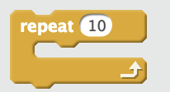
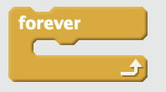
CONTROL BLOCKS
Repeats a certain chain of blocks for a certain number of times
Loops a certain chain of blocks infinite times

Slide 35
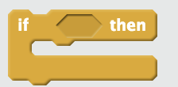
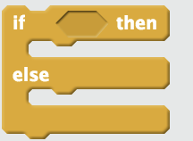
CONTROL BLOCKS
Executes a certain chain of blocks when a condition is met
Executes a certain chain of blocks when conditions are met and are not met

Slide 36
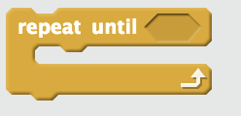
CONTROL BLOCKS
Repeats a certain chain of blocks until an event is completed or triggered

Slide 37
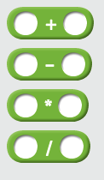

OPERATORS BLOCKS
Arithmetically operate on two variables
Picks a random integer given a certain range

Slide 38
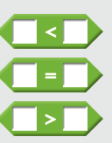
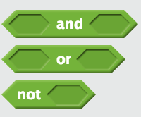
OPERATORS BLOCKS
Compares two variables and gives a boolean value
Conditional block that checks if two or one variables conditions are met

Slide 39
Challenge!
SITUATION: There is a ball and player. The ball is going to bounce n number of times. Once the ball stops bouncing, the player must go to the ball.
Notes:
Walk around and guide the kids lol
If you could demonstrate it yourself, do it
Don't forget to save your works!

